Slide 1
CPE 133
Review
Clocking Issues
Design Examples

Slide 2
General FSM Model

Slide 3
Illegal State Recovery
FSMs can have unused state
Occurs if # of FSM states is not a power of two
What happens when FSM finds itself in an unused state?
FSM could “hang”
Counter State Diagram: sequence = …6,0,5,7,3,6,0,5…

Slide 4
Hang States
What you want
What you might get
How to “fix it”

Slide 5
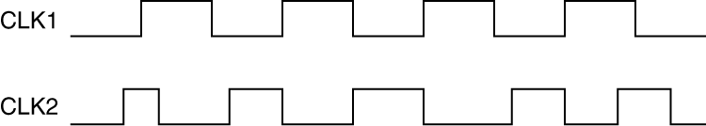
Clock Signals
Clocks are generally periodic in nature
Waveform repeats itself after a constant period of time
Period = the amount of time it requires for a clock signal to repeat itself
periodic
non-periodic

Slide 6
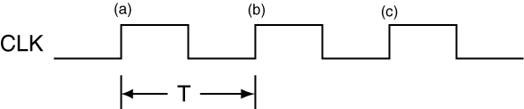
Period & Frequency
Period ➔ represented by T
Units: seconds
Frequency = 1/T (T⁻¹)
Units: seconds⁻¹ = Hertz = Hz

Slide 7
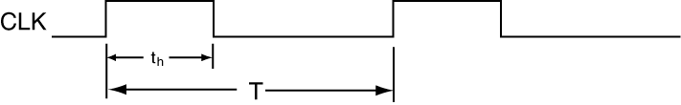
Clock Signal Attributes
Duty Cycle
Percentage of the signal period that the signal is in the high state
unitless

Slide 8
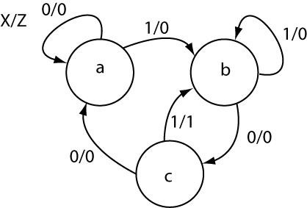
The State Diagram
Designed for the human viewer
looks better than a PS/NS table
Convey four types of information
states in the FSM
state transitions
inputs conditions (control the state transitions)
outputs
Moore (function of state)
Mealy (function of state and external inputs)

Slide 9
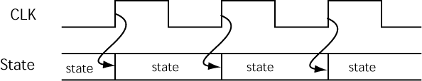

The State Bubble
Bubble represents a state
has a self-commenting name
defined by values in underlying storage elements
states are have temporal delineation
Most state changes are synchronized with clock edge
There as also asynchronous transfers
Present state? Next state?
Rising Edge Triggered Storage Elements

Slide 10
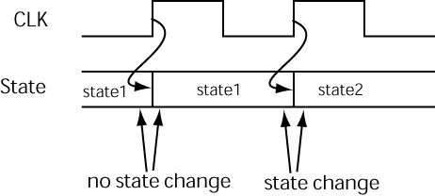
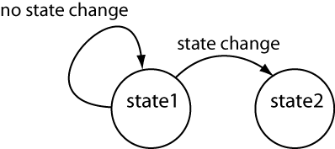
The State Diagram
Used to indicate “everything”
Changes in state
Conditions that cause state changes (external inputs)
Values of external outputs
Two types of state transitions
Self-loops
Transition to another state

Slide 11
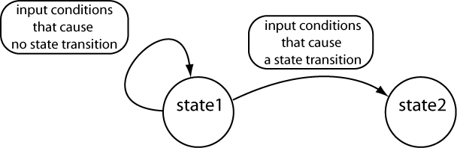
Controlling the Transitions
Transitions based on:
current state
current value of external inputs
Always list conditions that allow transition to occur
Unconditional transitions indicated with “-”

Slide 12
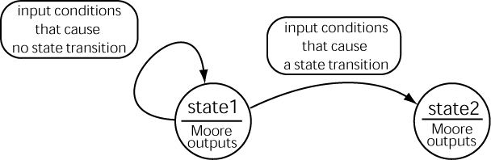
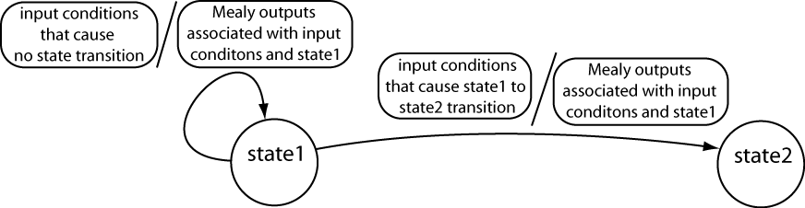
Representing Outputs
Moore Outputs
Mealy Outputs

Slide 13
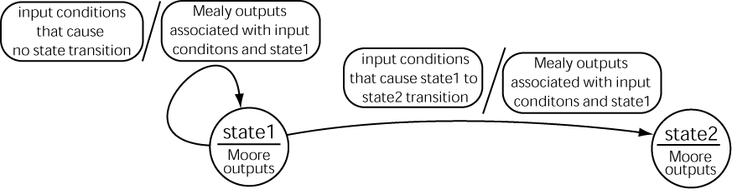
Representing Outputs
Mealy and Moore outputs

Slide 14
More FSMs
Primarily used as controller circuits
Also used to make
Specialty counters
Sequences other then increment & decrements
Synthesize signal
Varying frequency
Varying duty cycles

Slide 15
Design Problem #1
Design a circuit that blinks a single LED at half the input clock frequency with a 50% duty cycle. Include a black box diagram (BBD).
Design not using a FSM
Classic digital design circuit
Design using an FSM
Provide a state diagram

Slide 16
Solution

Slide 17
Design Problem #2
Design a circuit that blinks an LED. If the button is pressed, the LED stops blinking and either stays ON or stays OFF depending on when the button is pressed or not.
Include a black box diagram (BBD)
Include a state diagram

Slide 18
Solution

Slide 19
Design Problem #3
Design a circuit that blinks an LED. If the button is pressed, the LED stops blinking and turns off.
Include a black box diagram (BBD)
Include a state diagram

Slide 20
Solution

Slide 21
Design Problem #4
Design a circuit that blinks an LED with a 33.3% duty cycle at 60MHz.
Include a black box diagram (BBD)
Include a state diagram
Show the FSM clock frequency to obtain the 60MHz circuit specification

Slide 22
Solution

Slide 23
Design Problem #5
Design a circuit that blinks an LED with a 50% duty cycle if a button is pressed; otherwise the LED blinks with a 25% duty cycle. It’s OK for one duty cycle to be off in some cases where the button changes state.
Include a black box diagram (BBD)
Include a state diagram

